Slide 1
BC Fire Analysis
Anna Dorosheva
Anjanavarna Shaji
Ananya Wadhwa
Meyliani Sanjaya
Orkhan Pasha

Slide 2
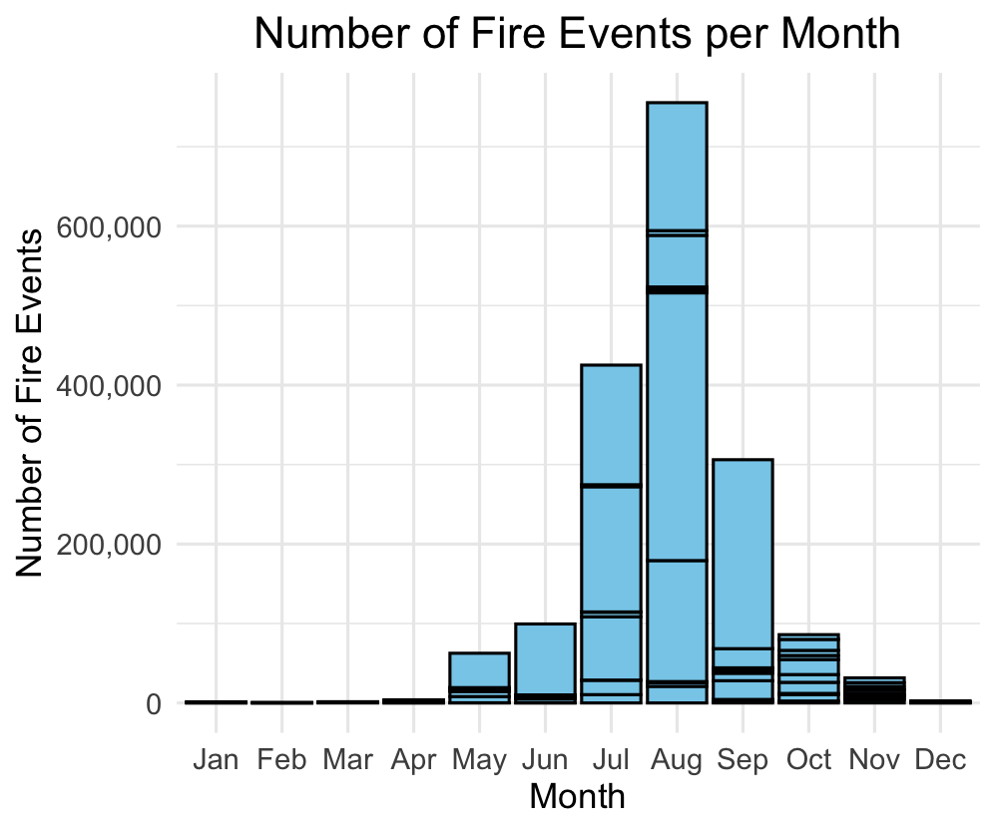
Scope of Analysis
Hotspot Data and Weather Data from 2014 – 2023
Data concentration within May – October or called as “peak”

Slide 3
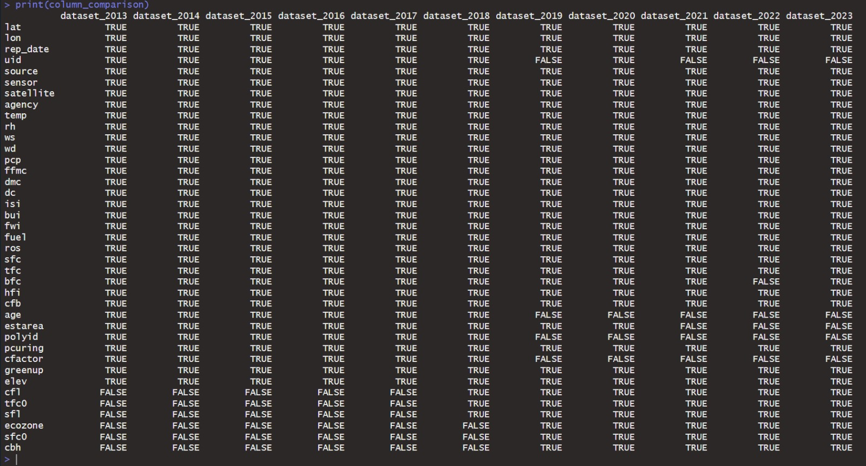
Scope of Analysis

Slide 4
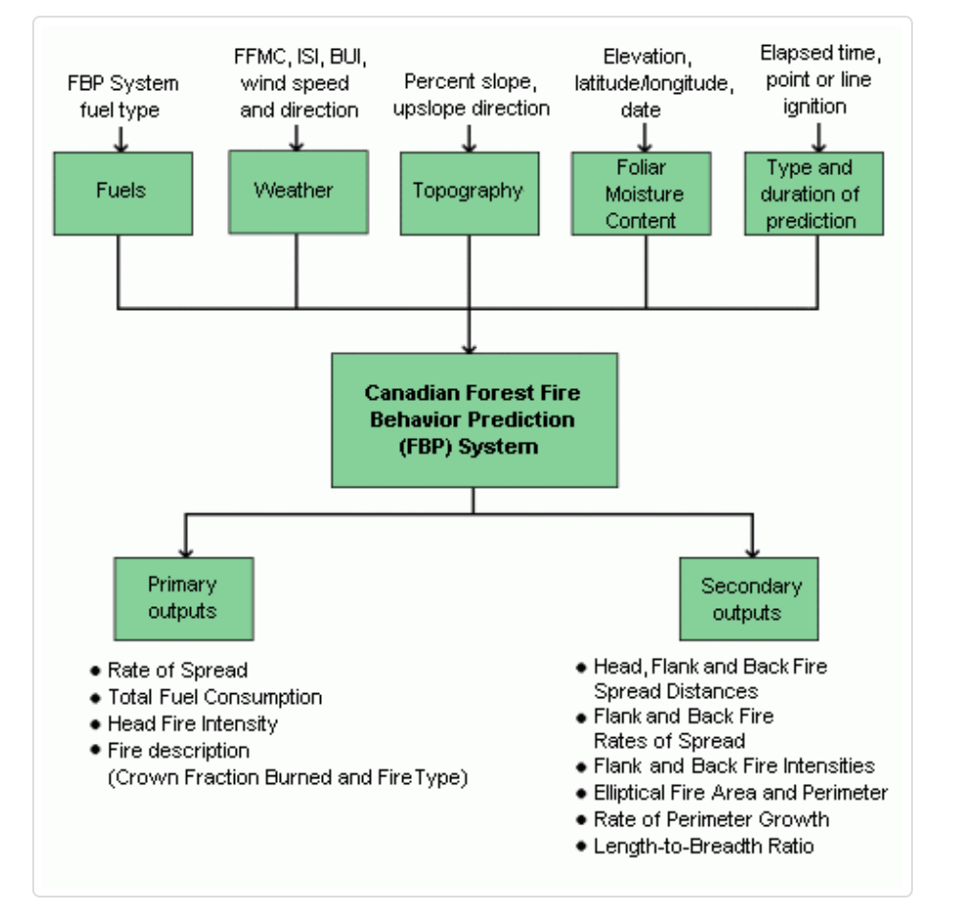
Scope of Analysis

Slide 5
Analysis
EDA Process to clean, select variable and ensure consistency
Clustering fire events using Density-Based spatial Clustering and Application with Noise (DBSCAN) and visualize it on the map.
Exploration of Variables (selected variables) : bar graphs for index
Trend Analysis with significant fire index
T-test for independent variable
Model

Slide 6
EDA
Hotspot
Dimension :
Missing Value in percentage
Fix inconsistency of data types (column)
Merge dataframe by binding rows
Weather
Dimension :
Missing Values in percentage
Fix inconsistency of data types
Merge dataframe by binding rows
zero_cfb <- hotspots_peak %>%
group_by(year) %>%
summarise(
total_count = n(),
zero_count = sum(cfb == 0, na.rm = TRUE),
zero_percentage = (zero_count / total_count) * 100
) %>%
arrange(desc(zero_percentage))
zero_cfb

Slide 7
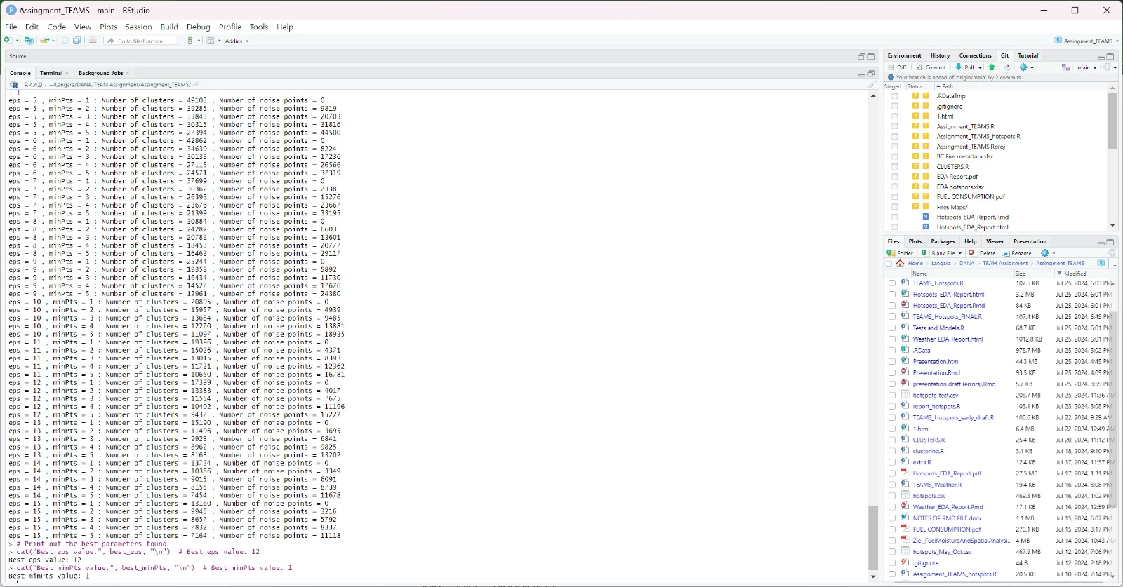
Clustering Fire Events
Apply DBSCAN (using iteration to find suitable radius and clustered into fire events)
* Include the valid information of events from BC Website, as the background of choosing particular eps,etc

Slide 8
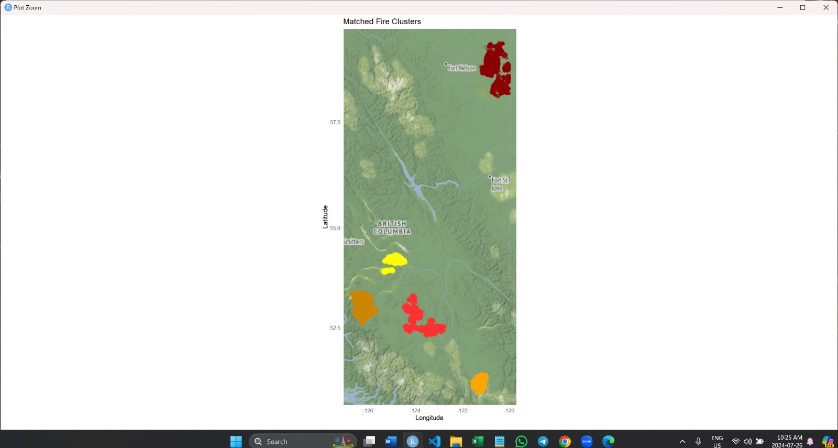
Clustering Fire Events
Top 5 Clusters:
# 1 4-25 Aug 66933(660 ha)
53.0 -126.
# Tweedsmuir Complex Fire (2018)
# 2 28Jul -13 Aug 61666
52.7 -124.
# Elephant Hill Fire (2017)
# 3 14-24 Sep 56406(50-1700ha) 58.7 -121.
# Fort Nelson Fire (2023)
# 4 5-22 Aug 34712
54.2 -125.
# Shovel Lake Fire (2018)
# 5 23 Jul – 13 Aug 30241 (239 ha) 51.0 -121.
# Hanceville-Riske Creek Fire (2017)
Legend :
Dark Brown = Fort Nelson
Mustard = Elephant Hill (right-down)
Red = Hanceville-Riske Creek Fire
Yellow = Shovel Lake Fire
Light Brown = Tweedsmuir Complex Fire
(next to red)

Slide 9
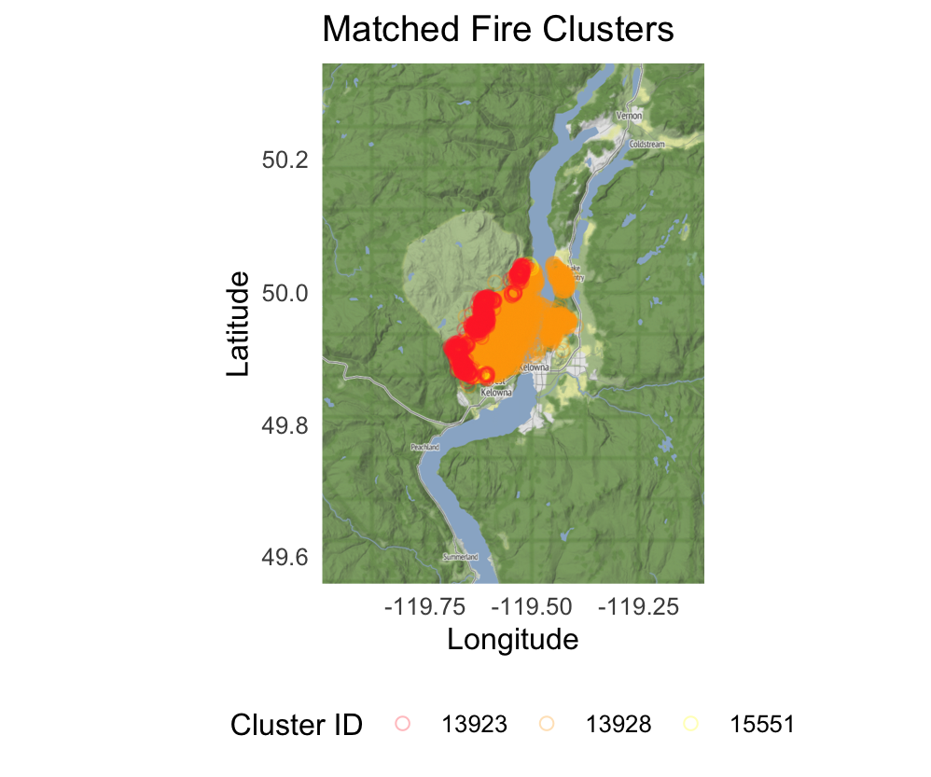
Clustering Fire Events
*) put real satellite image to compare

Slide 10
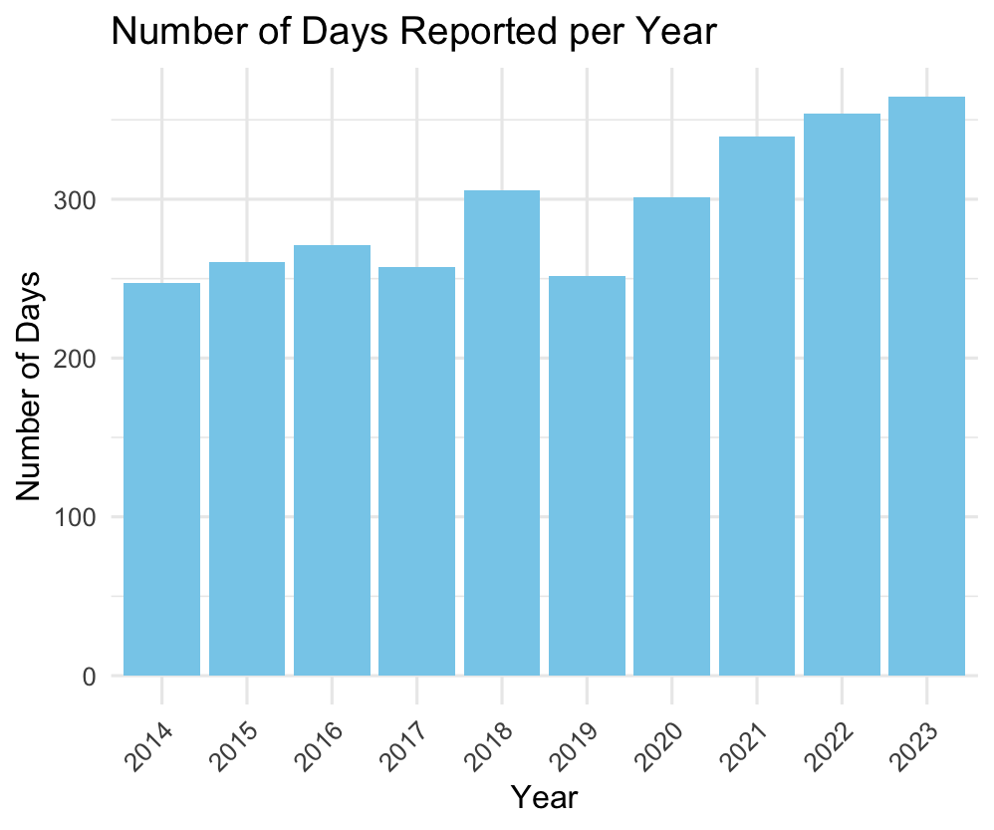
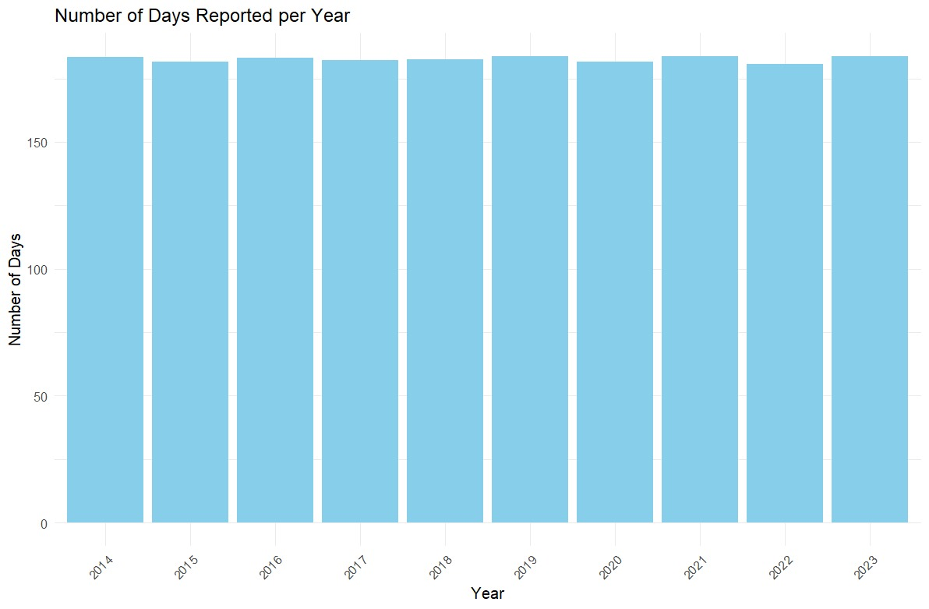
Exploration of Variables
Put bar graphs or plot of fire index variables
*) from full dataset, talk about the data collection

Slide 11
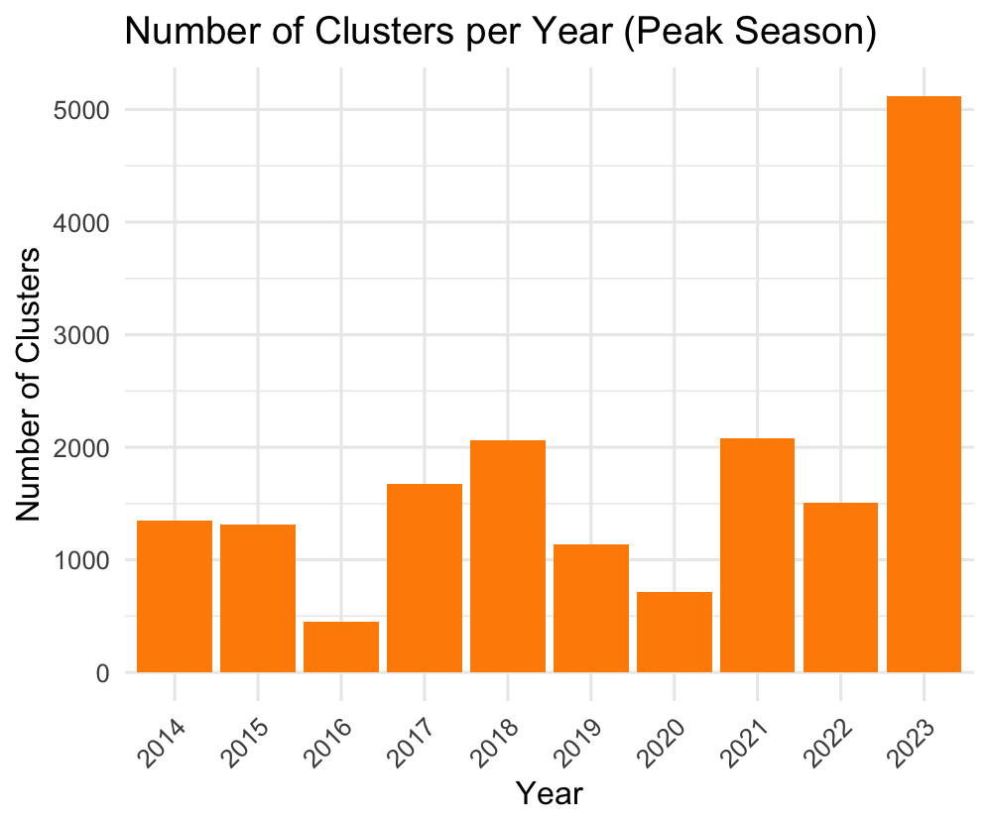
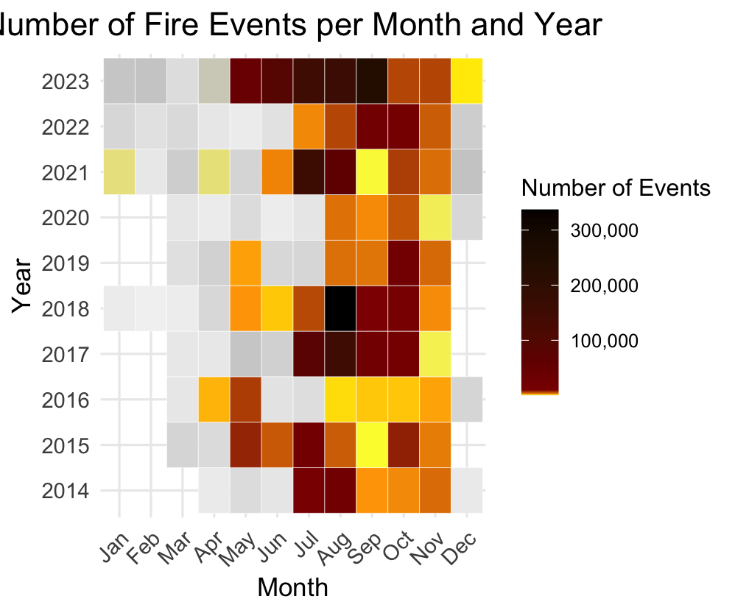
Exploration of Variables
Put bar graphs or plot of fire index variables

Slide 12
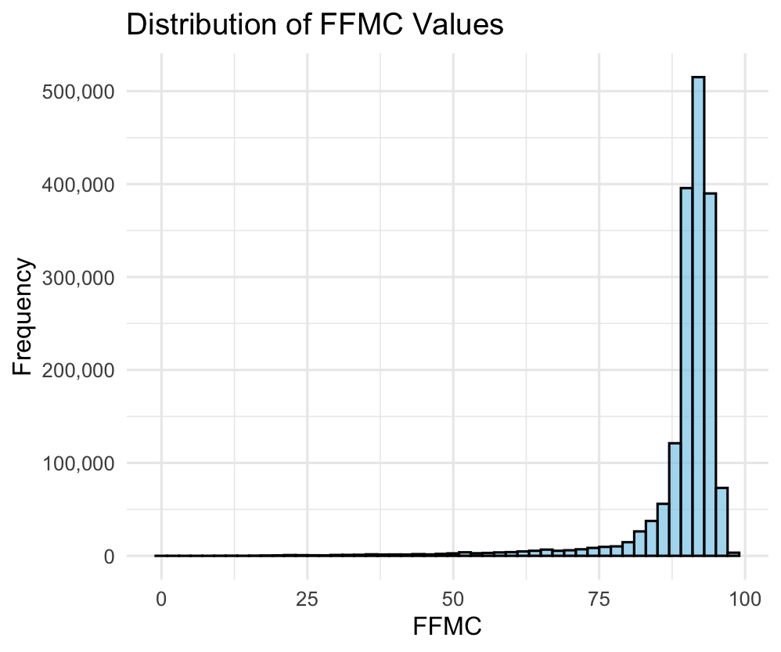
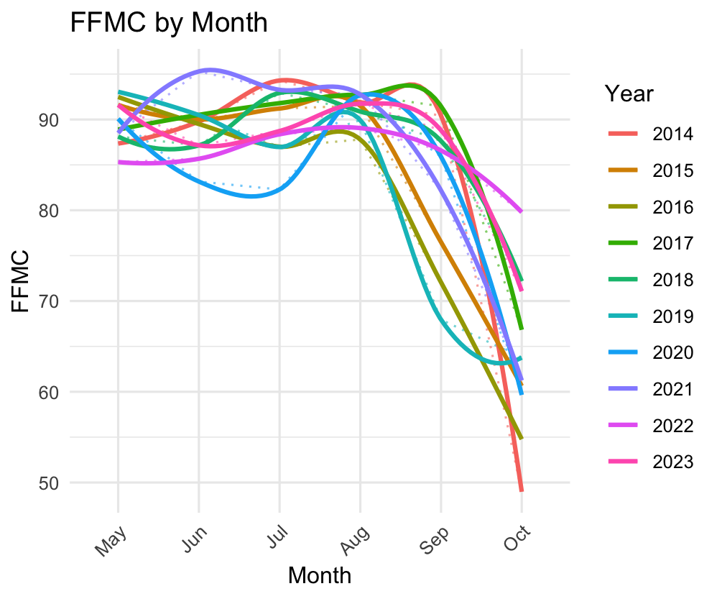
Exploration of Variables
Put bar graphs or plot of fire index variables

Slide 13
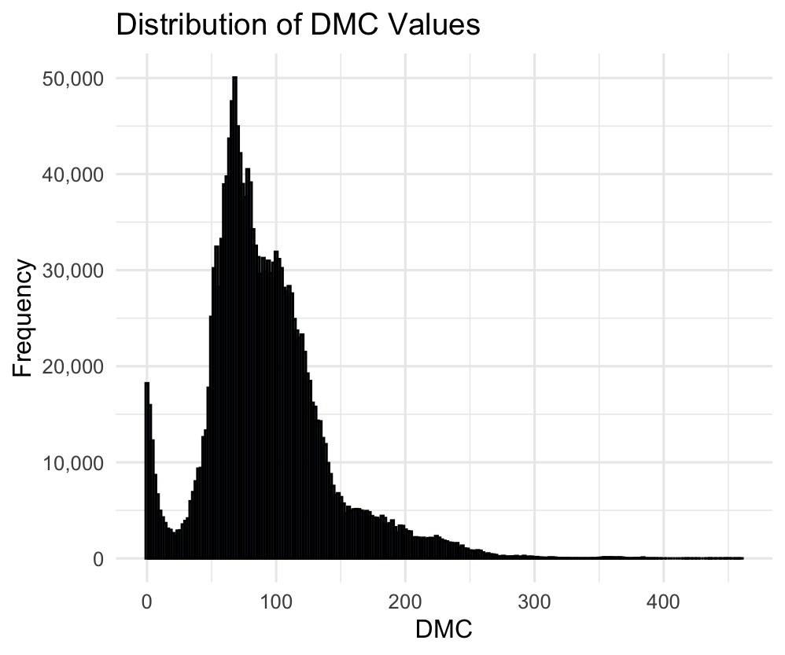
Exploration of Variables
Put bar graphs or plot of fire index variables
*) compare bar graphs with line plot with same variable – slide12 as refference

Slide 14
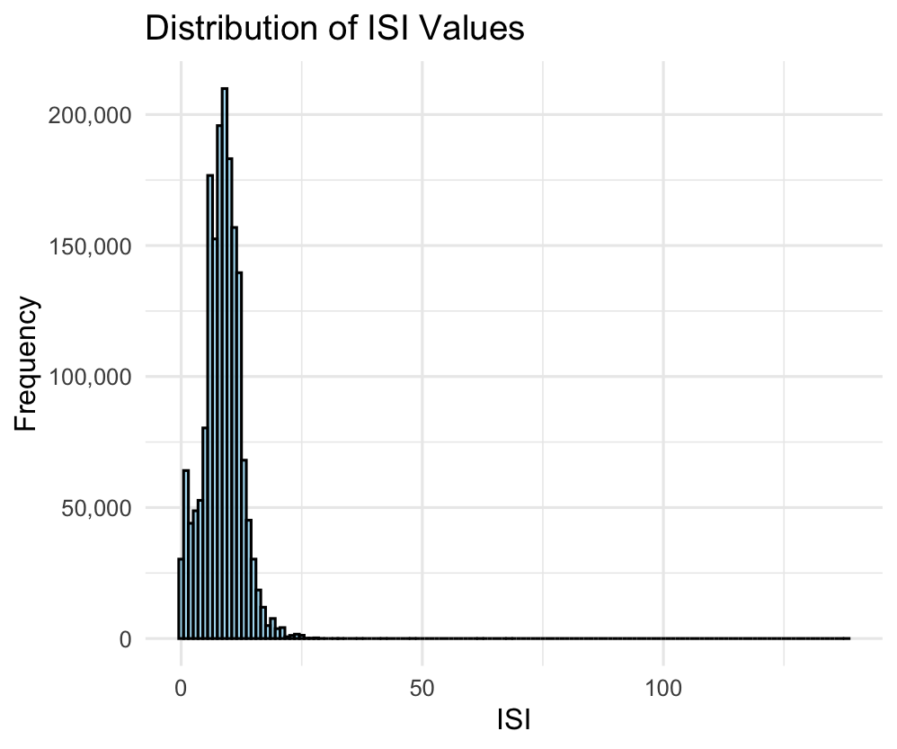
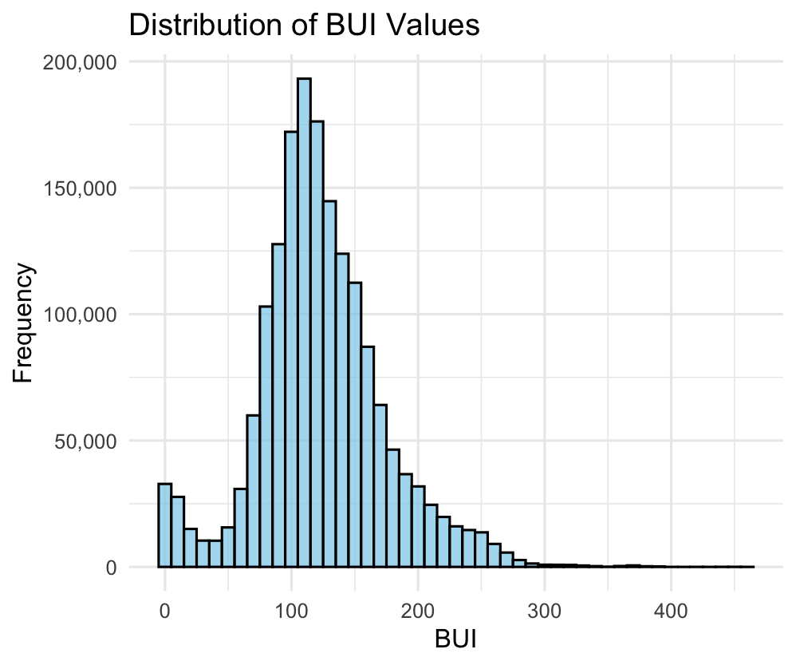
Exploration of Variables
Put bar graphs or plot of fire index variables

Slide 15
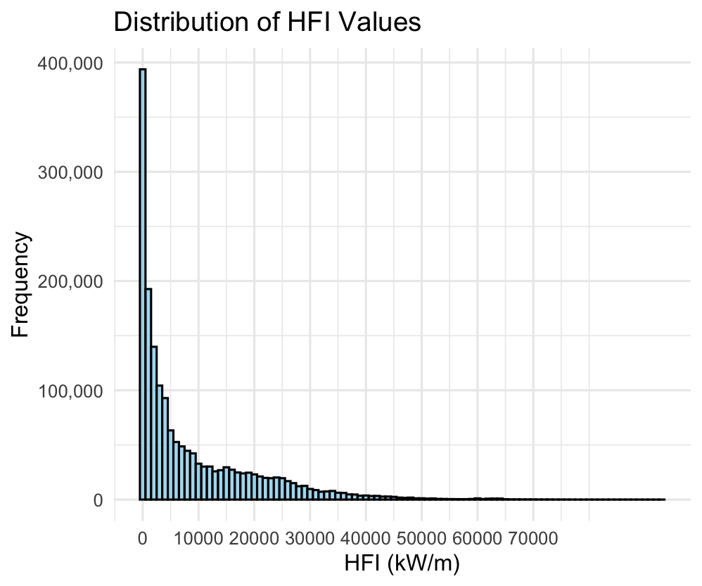
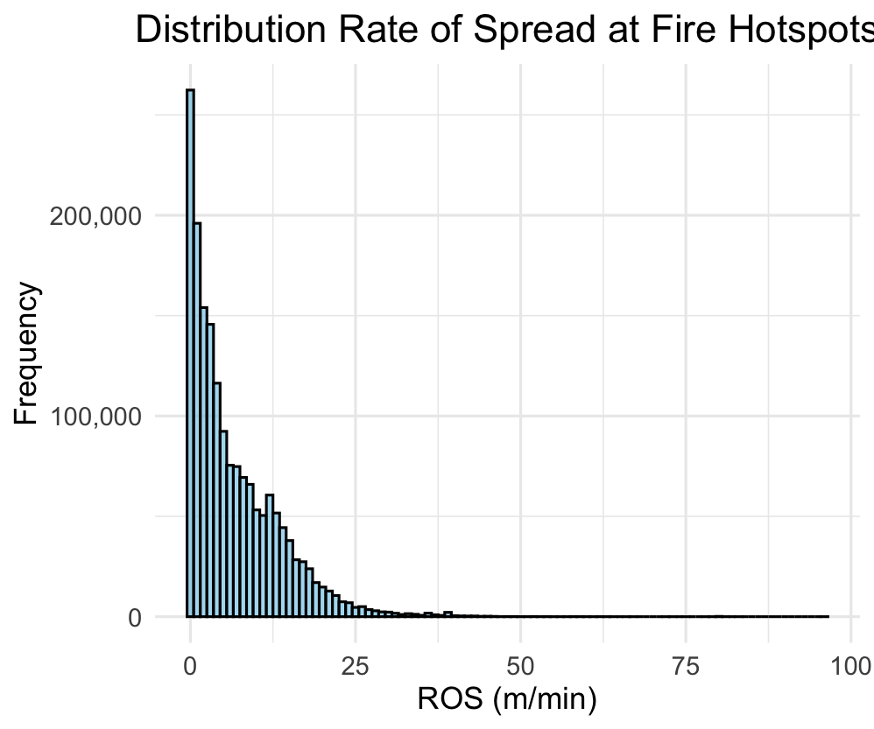
Exploration of Variables
Put bar graphs or plot of fire index variables

Slide 16
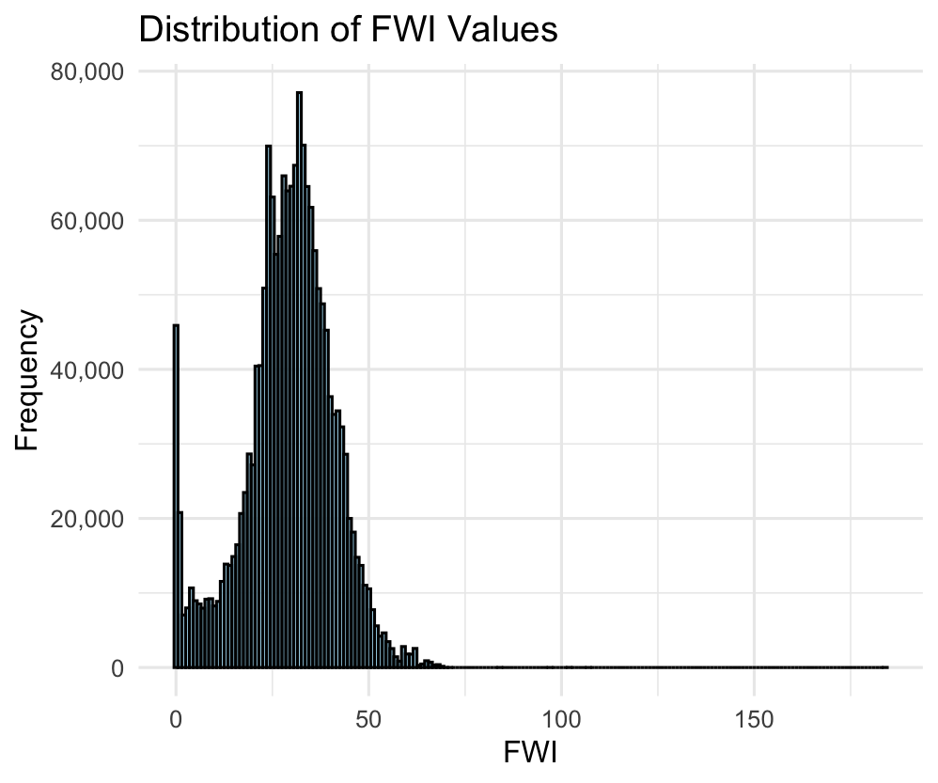
Exploration of Variables
Put bar graphs or plot of fire index variables
ADD DISTRIBUTION OF DC VALUE HERE!!

Slide 17
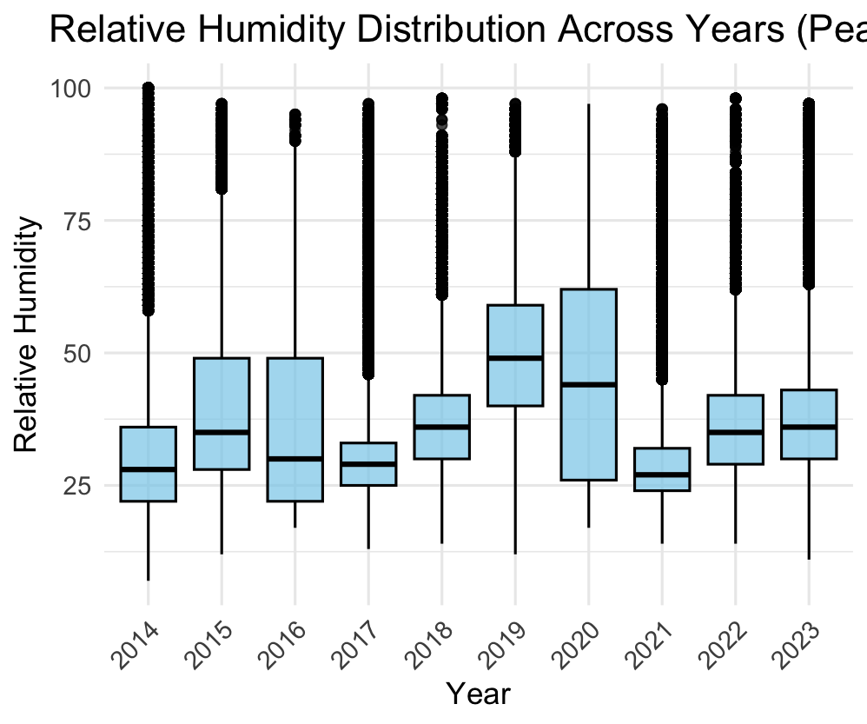
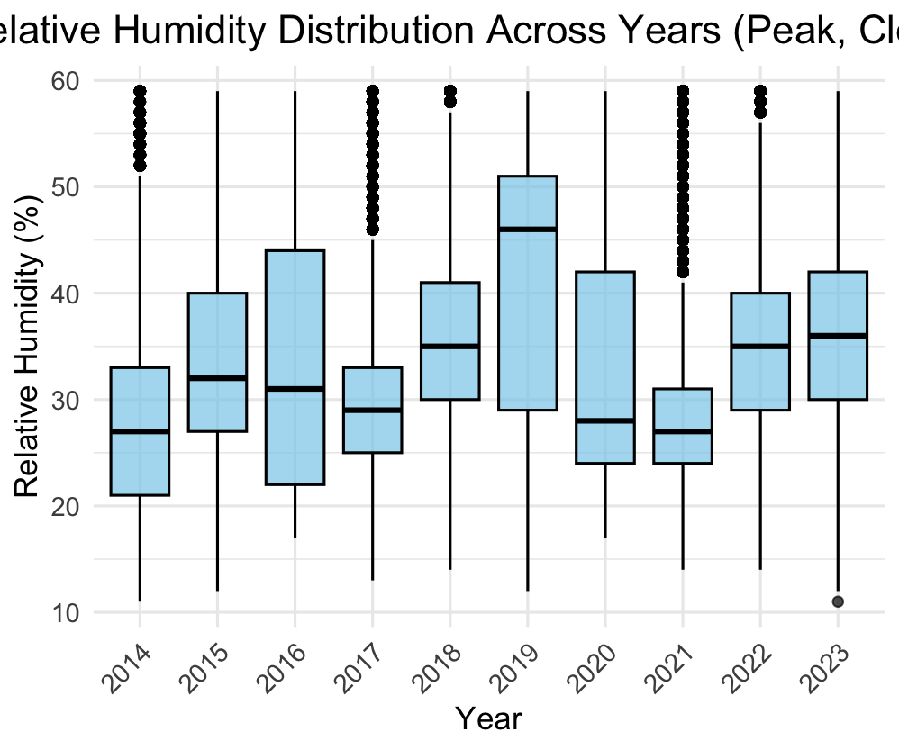
Boxplot (before vs removed outliers) for fire index and weather…(maybe)

Slide 18
PUT WEATHER GRAPHS HERE

Slide 19
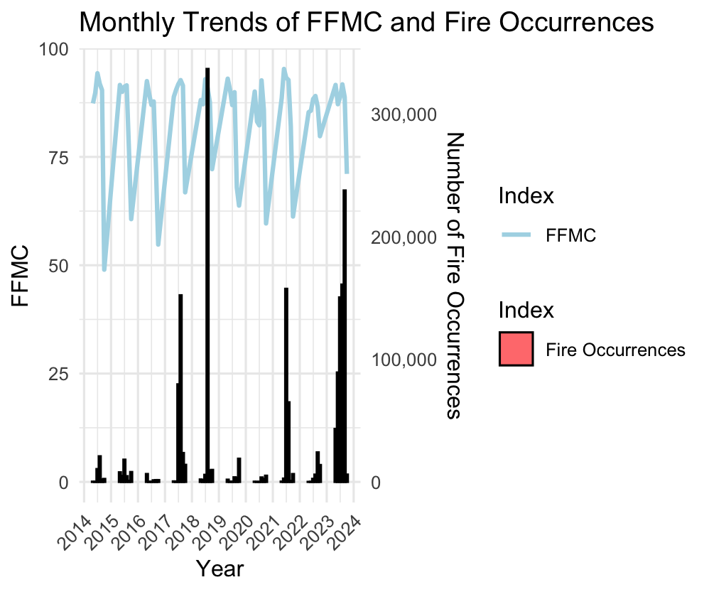
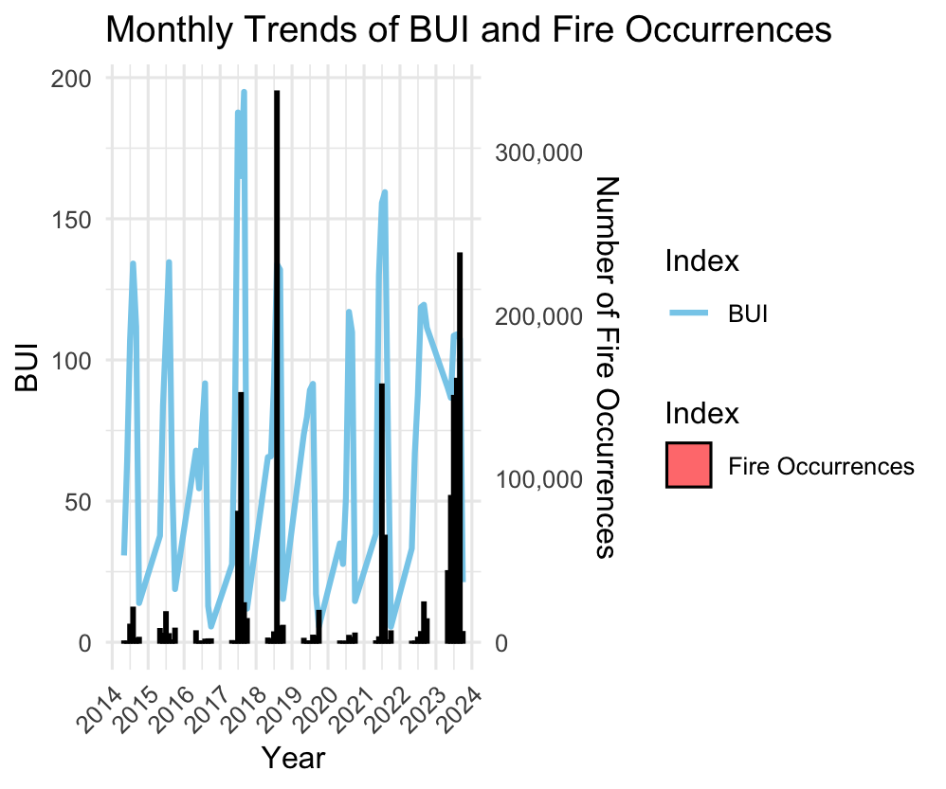
Trend Analysis
*) update with the latest graphs, focus legend

Slide 20
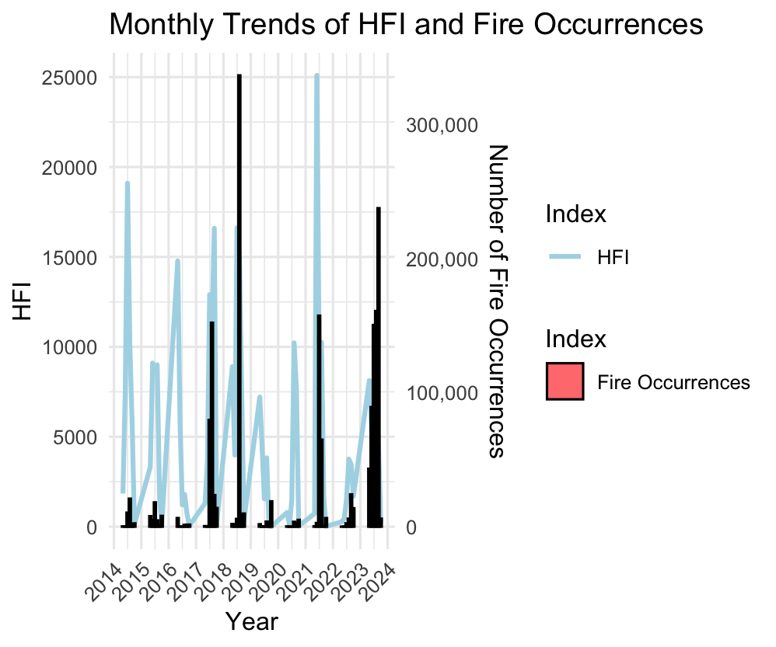
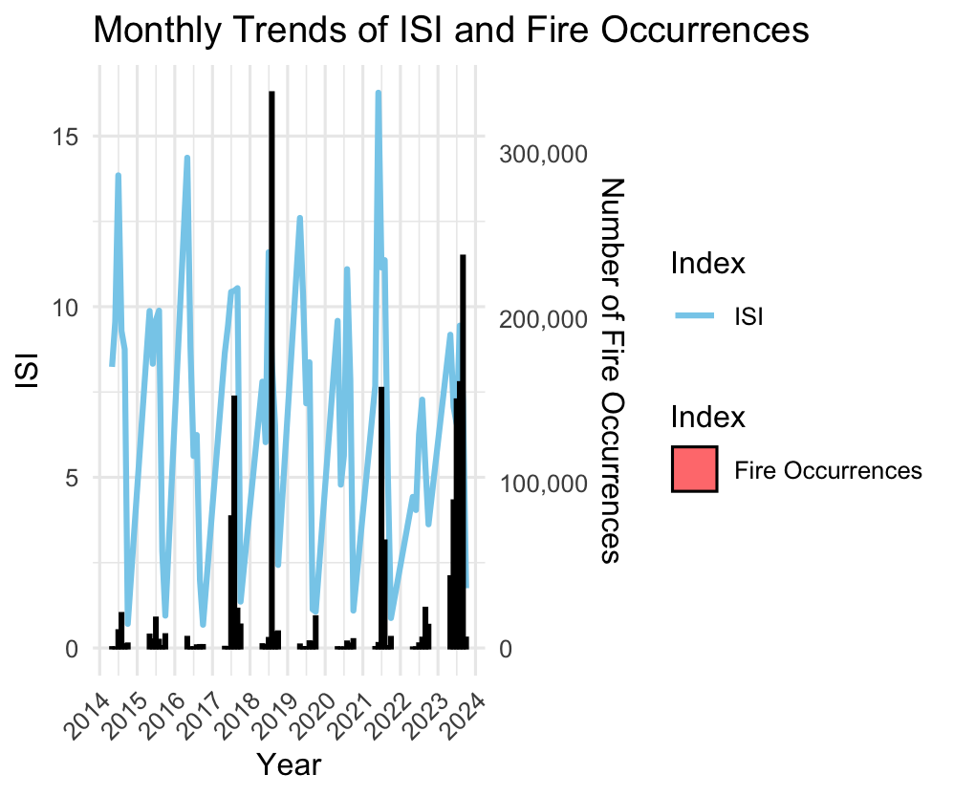
Trend Analysis

Slide 21
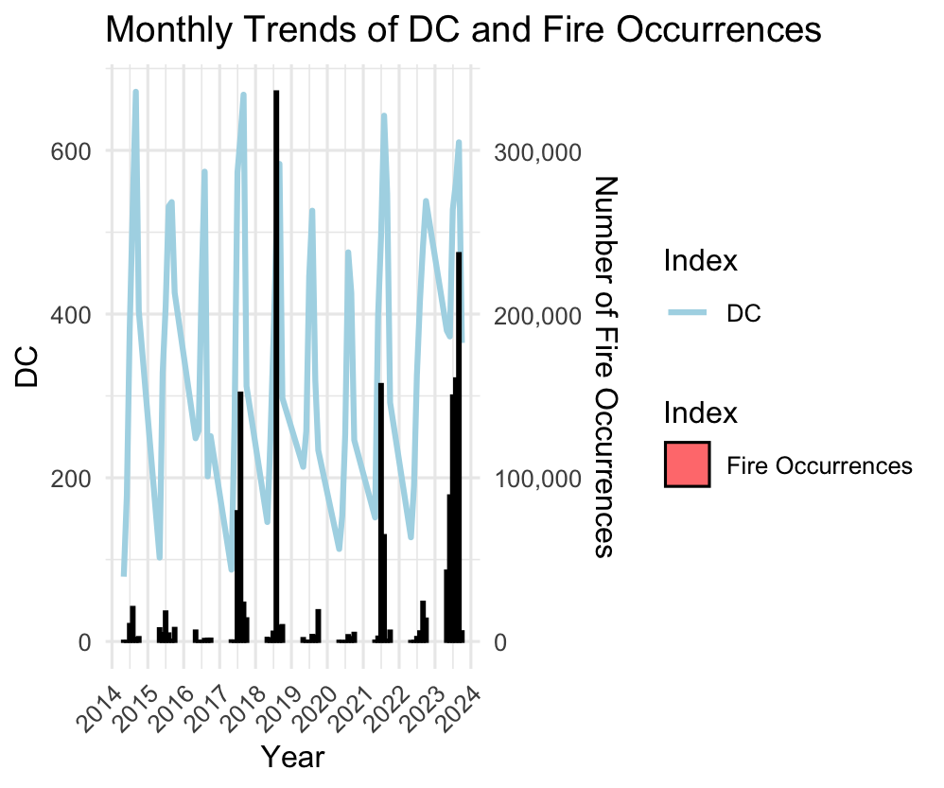
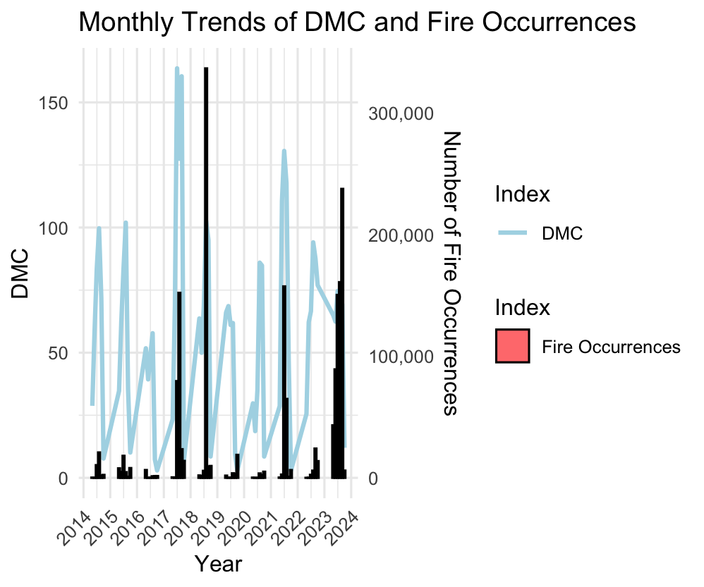

Trend Analysis

Slide 22
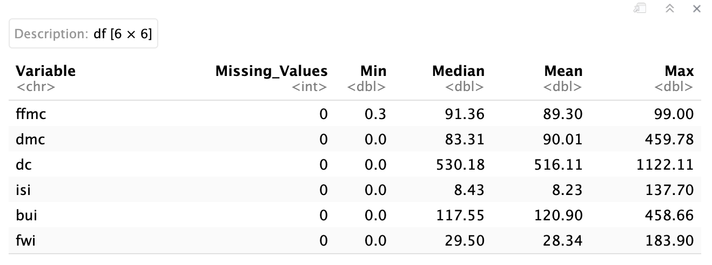
Testing procedures
Define the subset : choose variables for testing, ensure numerical, no NA, summarize

Slide 23
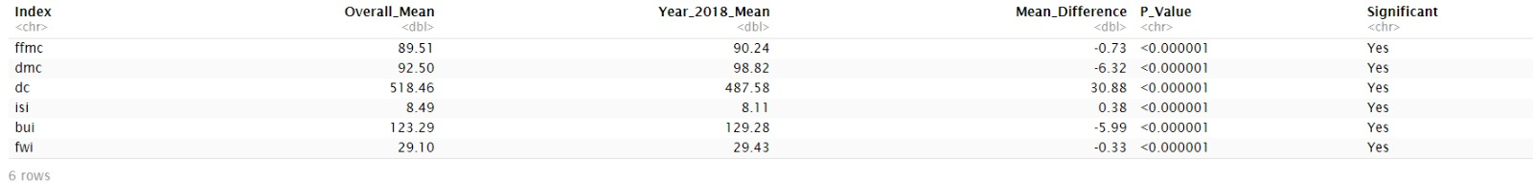
T-test
*From these calculations, we found that 2018 had a significantly higher number of observations and event clusters compared to the average over the ten-year period.*
*Despite the higher number of fire events, the main indices (FFMC, DMC, DC, ISI, BUI, FWI) remained close to their mean values across the dataset.*
*Therefore we wanted to test if the increased number of fires in 2018 was due to random chance or if other factors were at play.*
*We need to perform statistical tests to compare the indices for 2018 against the overall dataset.*

Slide 24
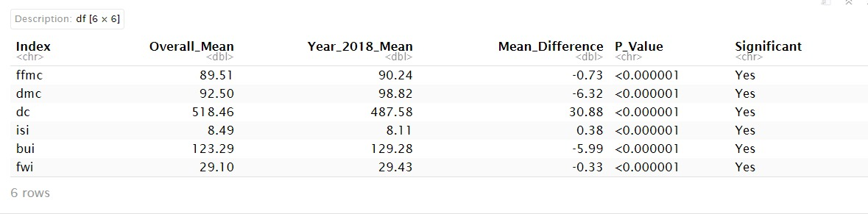
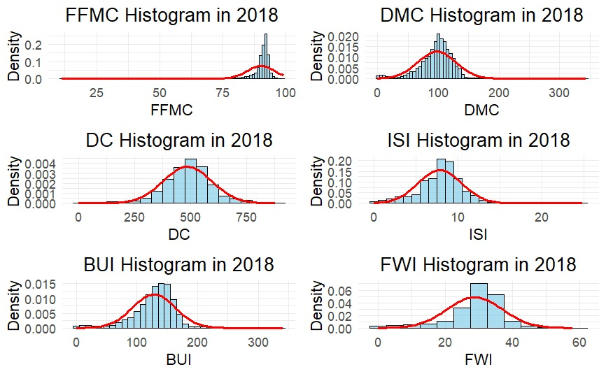
Wilcoxon Test

Slide 25
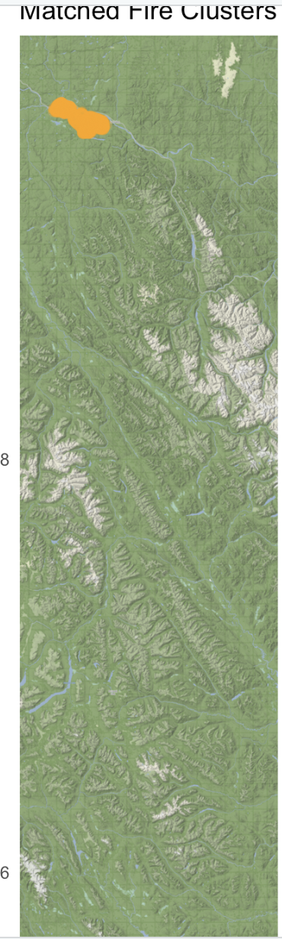
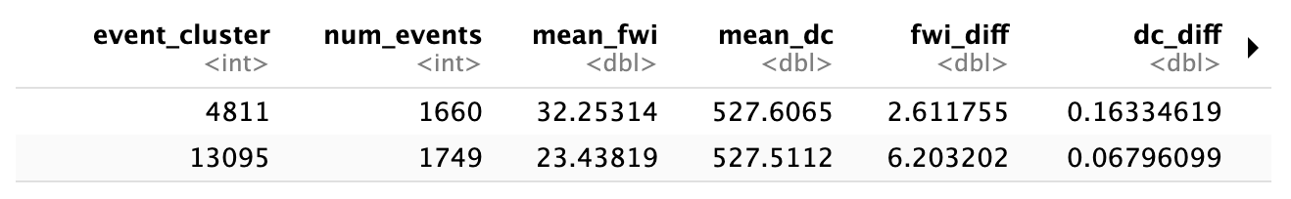
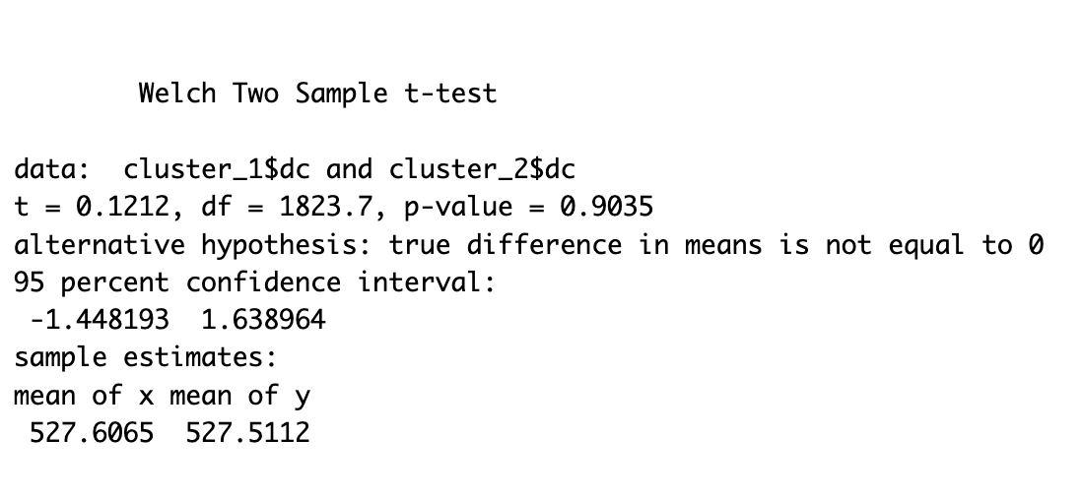
Analysis on two similar fire events
*We selected clusters based on the similarity of their mean Fire Weather Index (FWI) and Drought Code (DC).*
*) find the name of location or area

Slide 26
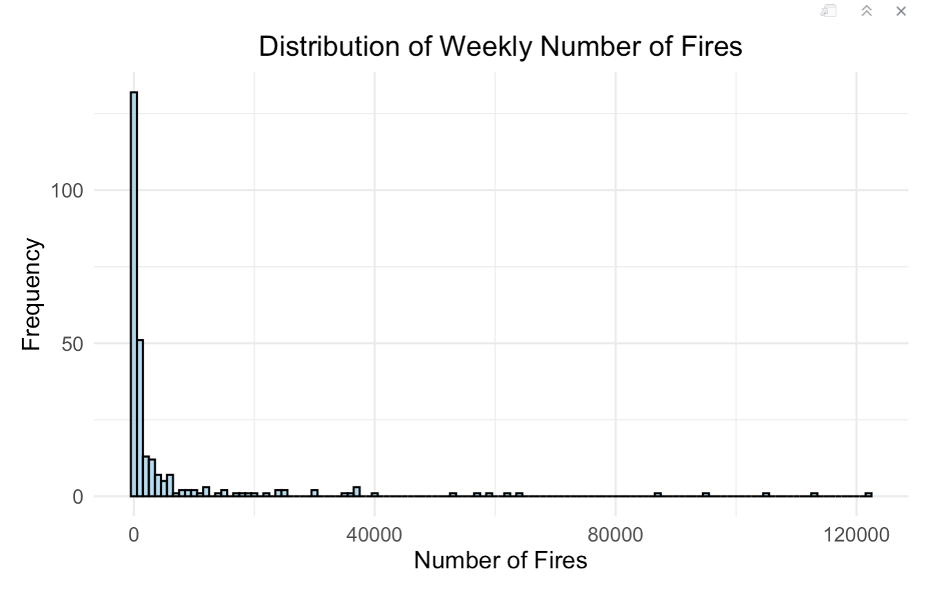
Linear Regression
Analyze the weekly number of fires using various fire index predictors.
The goal is to build a linear regression model to predict the number of fires and see its performance.

Slide 27
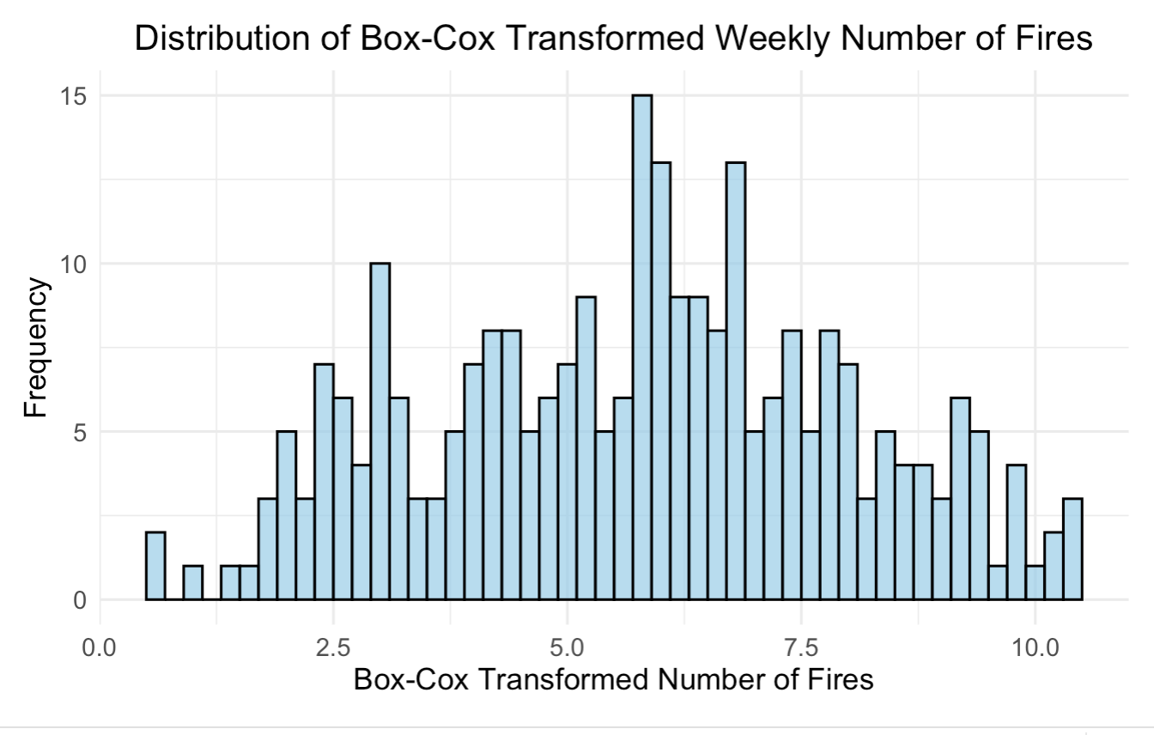
Linear Regression
Transform the number of fires to get more normally distributed data

Slide 28
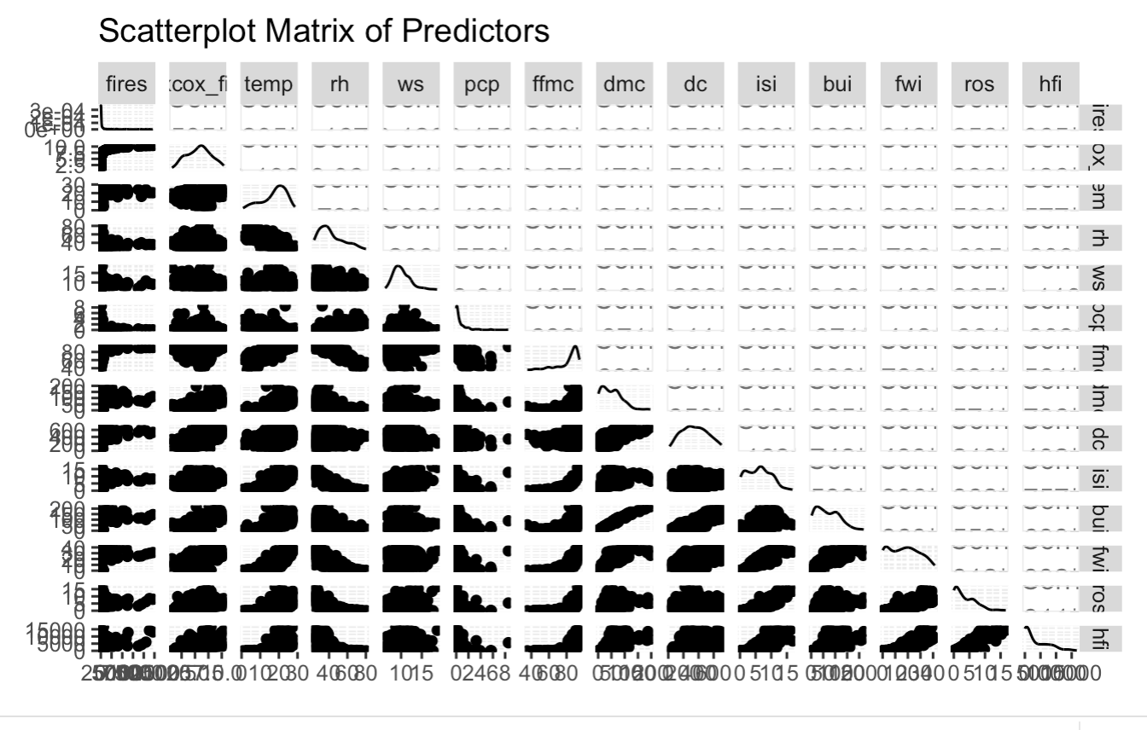
Linear Regression
*) need to update with visible and better scatterplot

Slide 29
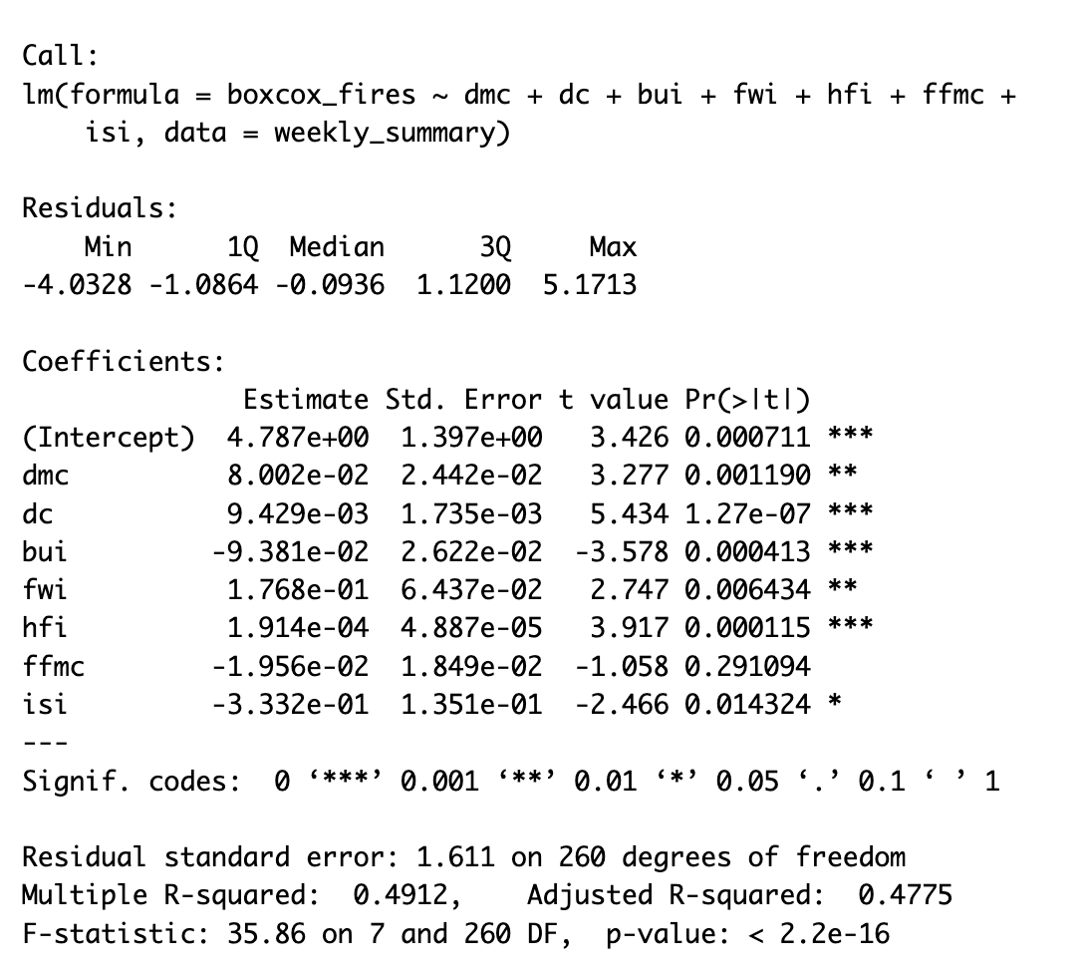
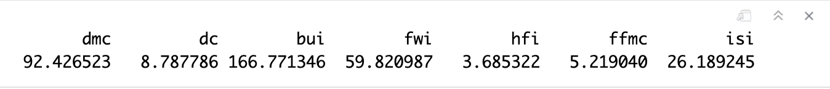
Model

Slide 30
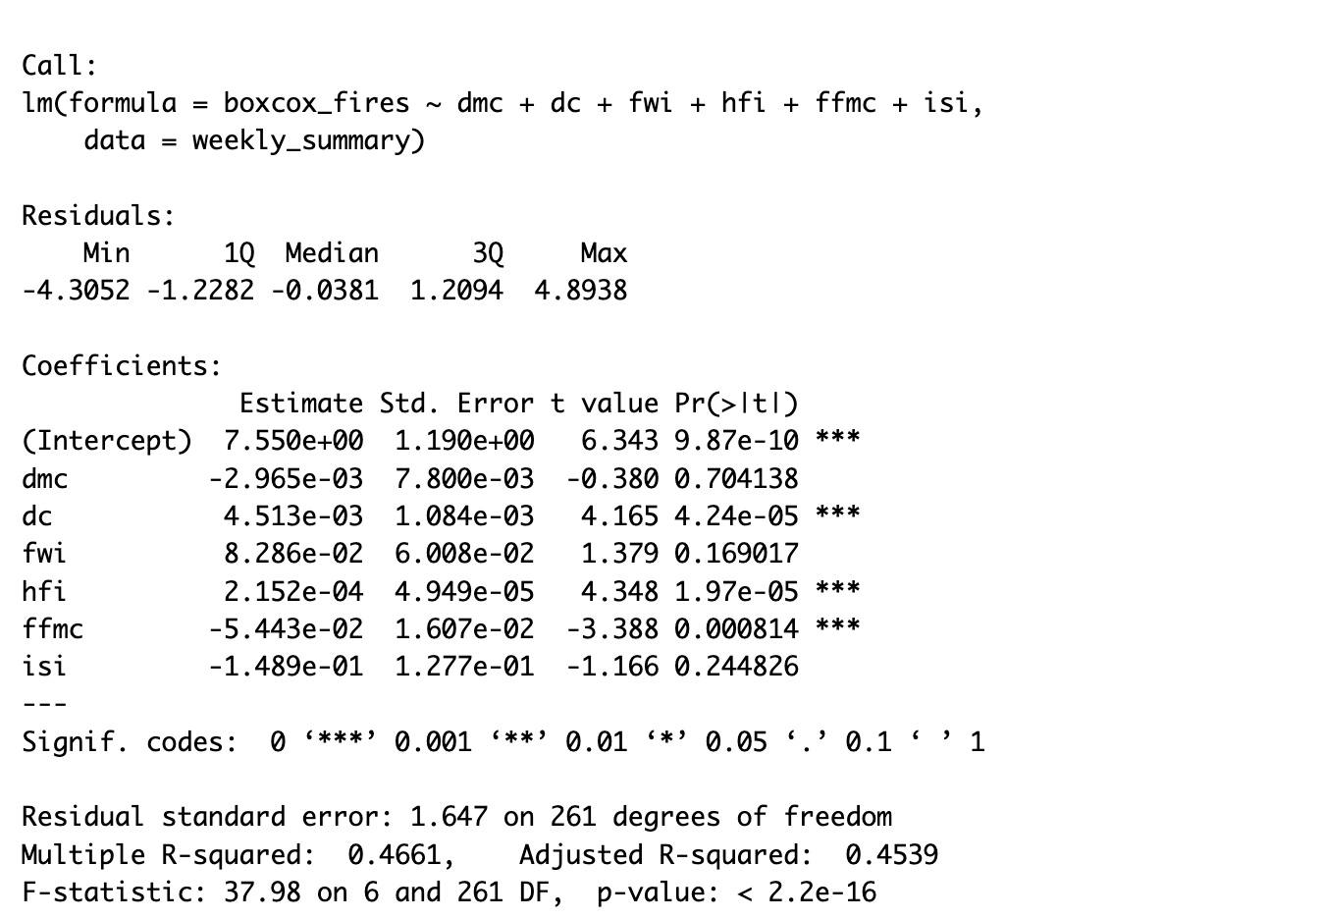
Model

Slide 31
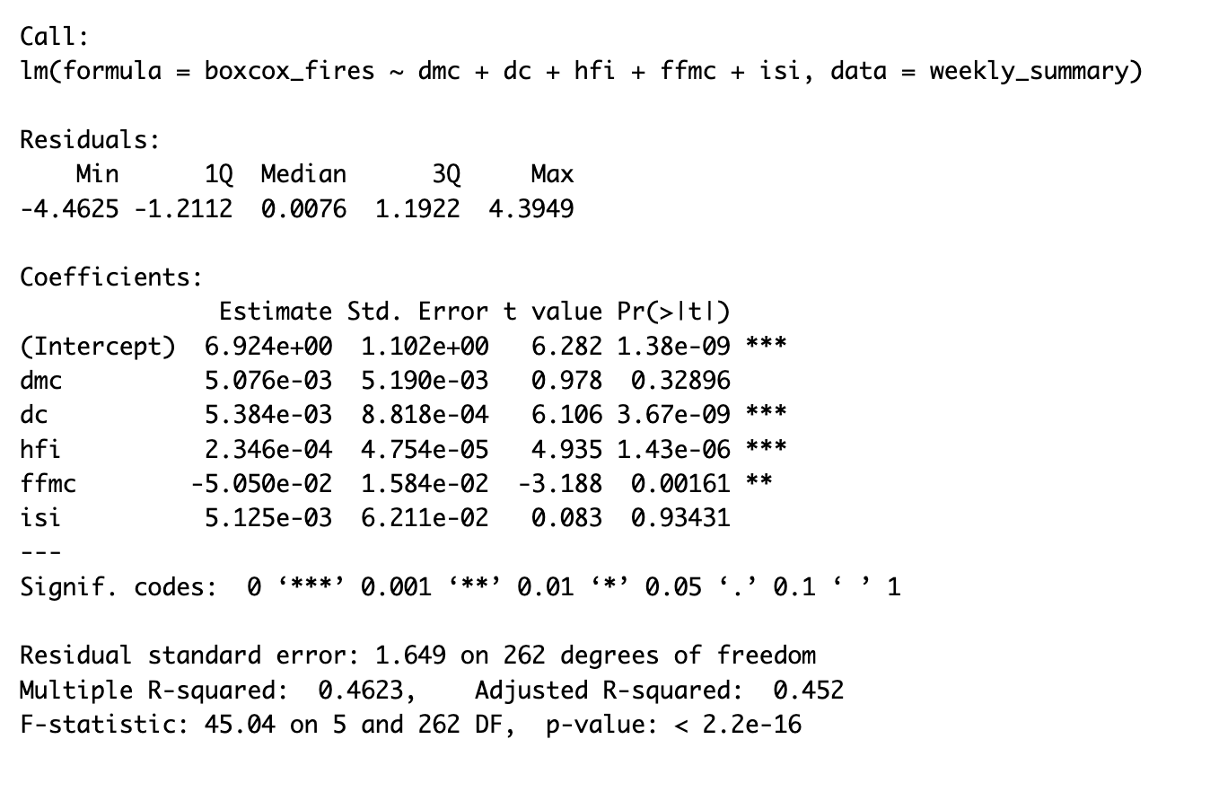
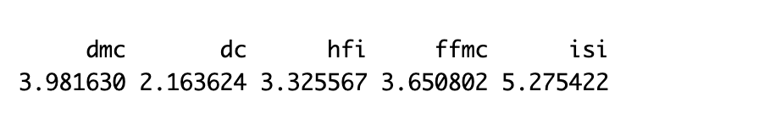
Model

Slide 32
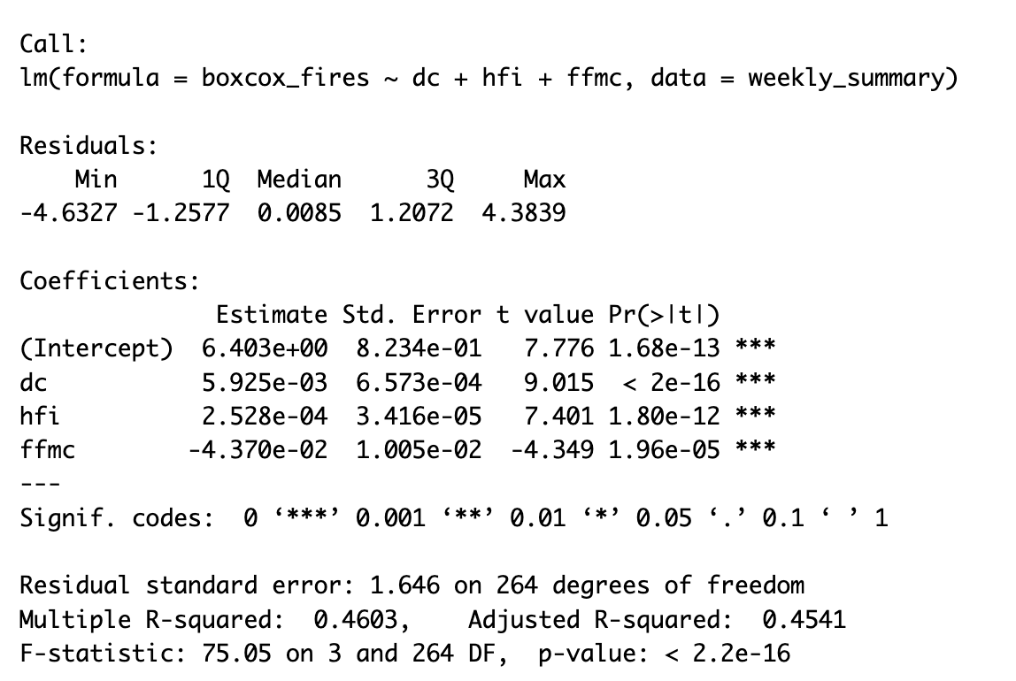
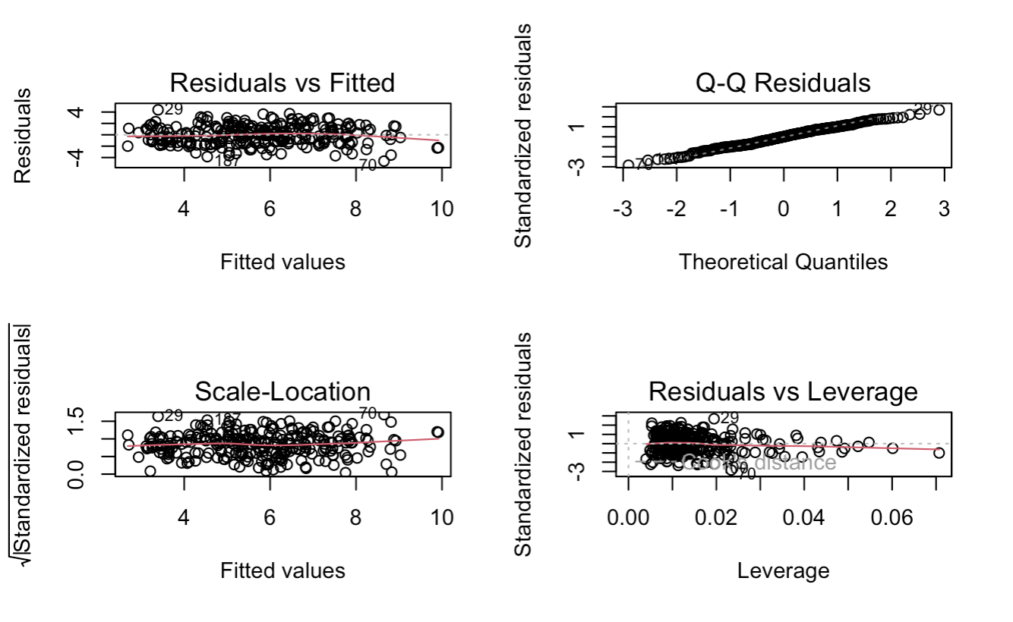
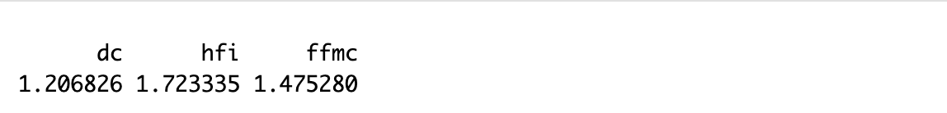
Final Model

Slide 33
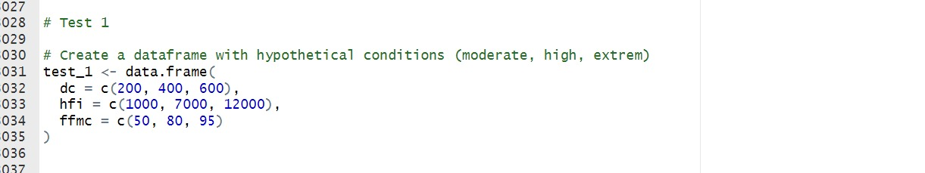
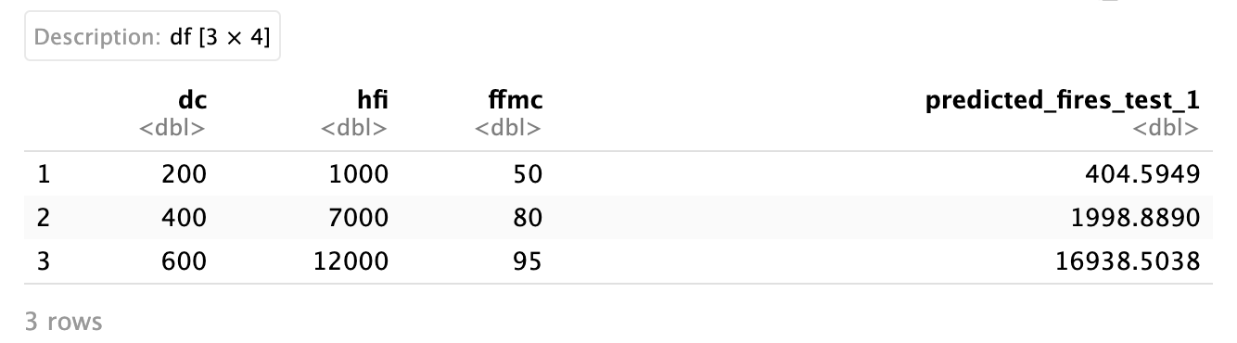
Model Testing

Slide 34
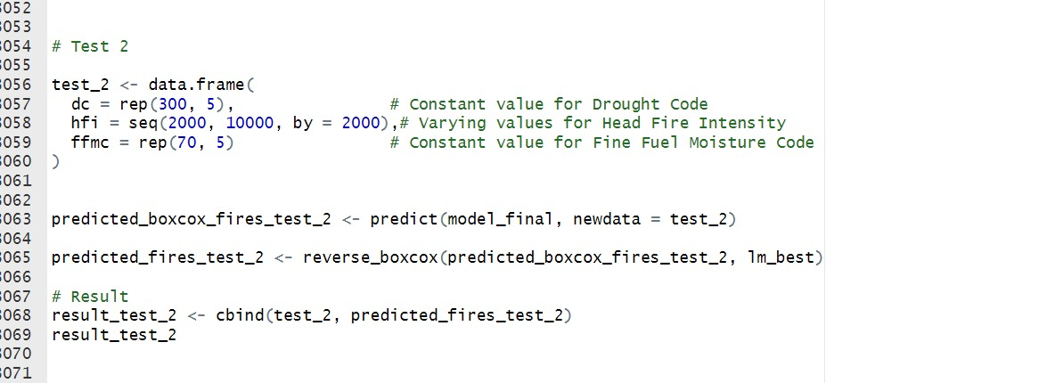
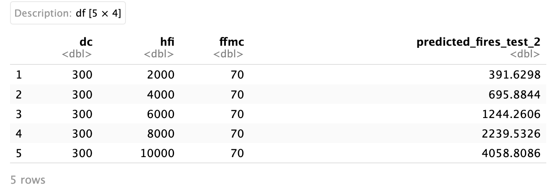
Model Testing

Slide 35
Model Testing
Put additional test 3 and 4

